Slide 1

MORNING
MANTRA
BEARS
BULLS
WHAT’S FALLING
WHAT’S RISING
Daily Derivatives & Market Report
Dec 30, 2021
COMPILED & PREPARED BY SHAH INVESTOR’S HOME LTD l ALL RIGHTS RESERVED

Slide 2
MARKET COMMENTARY
Extending previous session’s choppiness, Indian equity benchmarks ended the December F&O expiry trading session with marginal losses as traders remained watchful on account of rising corona cases as India recorded a dramatic surge in its Omicron tally by logging more than 900 cases. Soon after making a negative start, domestic bourses gained traction and traded in green for most part of the day as sentiments got some support as the FIEO said the country's exports are expected to register healthy growth rate in the financial year 2022-23 and might touch $530 billion as exporters are flushed with orders. It added that additional exports will come from some of the PLI (production-linked incentive) sectors in the next fiscal. Traders also took some support with private report stating that employment opportunities in the e-commerce and allied industries witnessed a 28 per cent surge in 2021, and recruitment activities in this segment will gain further momentum driven by economic recovery and aggressive vaccination drive.
Despite some volatility during noon deals markets traded with decent gains as traders took some relief from a note of the Reserve Bank of India’s (RBI) second Financial Stability Report (FSR) stated that the Omicron variant of coronavirus remains the major challenge along with rising inflation pressures, though the economy has steadily gained momentum and remained resilient since the second quarter of the current fiscal. Traders also took note of the I-T department’s statement that over 5 crore income tax returns (ITR) for the financial year ended March 2021 have been filed so far. However, traders opted to book all of their gains in dying hour of trade to end slightly in red as traders turned pessimistic as the Reserve Bank expressed doubts about the government’s ability to contain fiscal deficit at the budgeted 6.8 per cent this fiscal year after it moved the second supplementary demand of grants worth Rs 3.73 lakh crore which came in spite of a massive 83 per cent jump in net tax revenue so far this year to Rs 10.53 lakh crore.
On the global front, European stocks edged higher as holiday-thinned trade continues in the region. Market players have spent recent weeks juggling concerns over new Covid restrictions and tighter central bank policy with early studies suggesting omicron strain of the virus is milder than previous variants like delta. Asian markets ended mostly in red despite U.S. shares edging up to another record high overnight amid light volumes in the final days of the year.
COMPILED & PREPARED BY SHAH INVESTOR’S HOME LTD l ALL RIGHTS RESERVED

Slide 3
MARKET SELFIE
MARKET SUMMARY
Domestic Indices | Close | Points | % Change
SENSEX | 57794.32 | -12.17 | -0.02
NIFTY | 17203.95 | -9.65 | -0.06
MIDCAP | 24630.81 | -54.05 | -0.22
SMLCAP | 29121.04 | 55.01 | 0.19
BSEFMC | 13611.44 | 11.46 | 0.08
AUTO | 24394.74 | -145.72 | -0.59
POWER | 3469.27 | -26.05 | -0.75
REALTY | 3792.97 | -38.02 | -0.99
BSE IT | 37812.32 | 361.27 | 0.96
BANKEX | 39866.49 | 13.08 | 0.03
OIL GAS | 17306.55 | -250.54 | -1.43
METAL | 18849.42 | -219.55 | -1.15
INDIA VIX | 16.57 | 0.33 | 2.02
ADVANCE - DECLINE
Index | Advance | Decline | Unchanged
NSE | 967 | 1144 | 47
BSE | 1784 | 1584 | 92
MARKET TURNOVER (₹ in Crs)
Segment | Current | Previous | Net %
BSE CASH | 3908 | 4057 | (4)
NSE CASH | 53784 | 43789 | 23
NSE F&O | 12317453 | 6241101 | 97
KEY INDICES RATIOS
INDEX | P/E | P/B | Dividend Yield
NIFTY | 23.73 | 4.31 | 1.21
SENSEX | 27.63 | 3.60 | 0.93
COMPILED & PREPARED BY SHAH INVESTOR’S HOME LTD l ALL RIGHTS RESERVED

Slide 4
KEY NUMBERS TRACKER
FII – DII ACTIVITY IN CASH SEGMENT (₹ in Crs)
FII-DII* | Buy | Sell | Net
DII | 9450 | 8873 | 578
FII | 4512 | 5498 | (986)
Note: FPI & DII Figures are provisional
FII ACTIVITY IN DERIVATIVES SEGMENT (₹ in Crs)
FII | Buy | Sell | Net
Index Futures | 6888.33 | 6463.19 | 425
Index Options | 930962.85 | 940117.56 | (9155)
Stock Futures | 23827.98 | 22675.39 | 1153
Stock Options | 12953.83 | 10809.54 | 2144
PUT-CALL RATIO
PUT-CALL RATIO
Index | Current | Previous
NIFTY | 1.18 | 1.20
BANK NIFTY | 0.87 | 0.72
DOLLAR INDEX
Dollar Index | Current | Previous | % Change
DXY | 96.10 | 95.93 | 0.18
10-YEARS G-SEC YIELD
Country | Current | Previous | % Change
INDIA | 6.469 | 6.469 | 0.00
USA | 1.524 | 1.543 | -1.24
KEY COMMODITIES TRACKER (in $)
Commodity | Current | Change Points | % Change
Gold | 1813.67 | 9.37 | 0.52
Silver | 23.05 | 0.22 | 0.95
Crude-Oil | 76.92 | 0.36 | 0.47
Brent-Crude | 79.15 | -0.08 | -0.10
COMPILED & PREPARED BY SHAH INVESTOR’S HOME LTD l ALL RIGHTS RESERVED

Slide 5
CURRENCY FUTURES & INDEX TRENDS TRACKER
CURRENCY FUTURES
Expiry | Close | Change Points | % Change
27 Jan -21 USD-INR | 74.63 | -0.33 | -0.44
27 Jan -21 EUR-INR | 84.61 | -0.11 | -0.13
27 Jan -21 GBP-INR | 100.70 | 0.05 | 0.05
27 Jan -21 JPY- INR | 64.88 | -0.36 | -0.56
INDICES – SUPPORT-RESISTANCE-PIVOT LEVELS
Index | Close | S2 | S1 | Pivot | R1 | R2
NIFTY | 17204 | 17087 | 17146 | 17205 | 17263 | 17322
SENSEX | 57794 | 57363 | 57579 | 57794 | 58010 | 58225
NIFTY FUTURES | 17207 | 17099 | 17153 | 17206 | 17260 | 17313
BANK NIFTY | 35064 | 34570 | 34817 | 34998 | 35245 | 35426
CNX IT | 38659 | 37826 | 38242 | 38570 | 38986 | 39314
CNX MIDCAP | 30023 | 29839 | 29931 | 30038 | 30130 | 30237
CNX SMALLCAP | 11132 | 11056 | 11094 | 11132 | 11170 | 11208
INDIA VIX | 16.57 | 14.72 | 15.64 | 16.22 | 17.14 | 17.72
INDEX TREND ANALYSIS
Index | Daily | Weekly | Monthly
NIFTY | Neutral | Neutral | Buy
SENSEX | Neutral | Neutral | Buy
NIFTY FUTURES | Neutral | Neutral | Buy
BANK NIFTY | Sell | Neutral | Neutral
CNX IT | Buy | Buy | Buy
CNX MIDCAP | Neutral | Neutral | Buy
CNX SMALLCAP | Buy | Neutral | Buy
INDIA VIX | Neutral | Neutral | Neutral
SECURITIES BAN IN F&O TRADES FOR 31-12-2021
NIL
COMPILED & PREPARED BY SHAH INVESTOR’S HOME LTD l ALL RIGHTS RESERVED

Slide 6
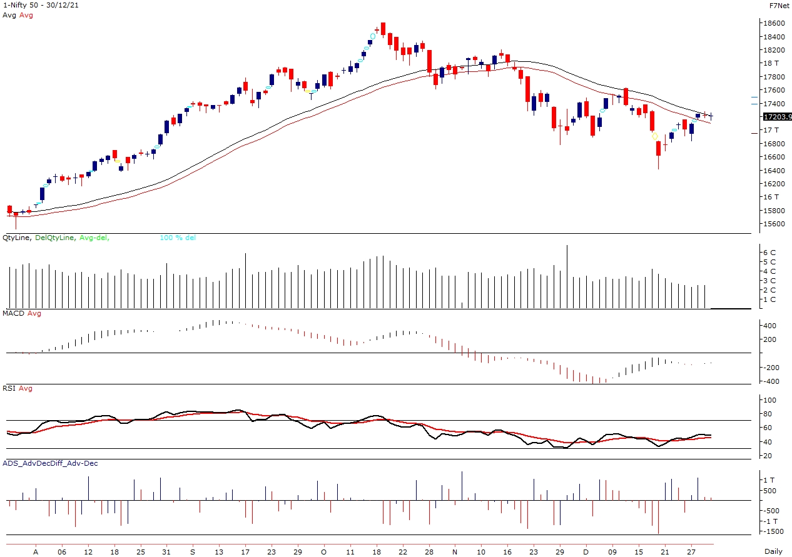
TECHNICAL VIEWS
NIFTY
Nifty Cash = 17,203.95 (-0.06)
Resistance levels = 17,270 and 17,390
Support levels = 17,180 and 17,080
COMPILED & PREPARED BY SHAH INVESTOR’S HOME LTD l ALL RIGHTS RESERVED

Slide 7
TECHNICAL VIEWS
NIFTY FUTURES
COMPILED & PREPARED BY SHAH INVESTOR’S HOME LTD l ALL RIGHTS RESERVED

Slide 8
TECHNICAL VIEWS
BANK NIFTY FUTURES
COMPILED & PREPARED BY SHAH INVESTOR’S HOME LTD l ALL RIGHTS RESERVED

Slide 9
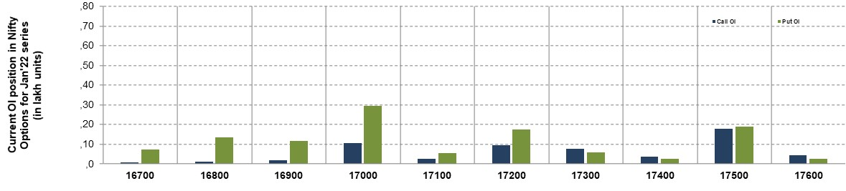
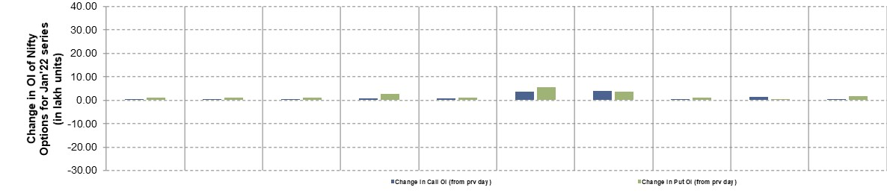
TECHNICAL VIEWS
NIFTY OPTIONS
Most Active Nifty Call with an addition of 0.15 million in Open Interests is Strike Price of 17,500
Most Active Nifty Put with an addition of 0.30 millions in Open Interests is Strike Price of 17,000
Maximum Open Interest an outstanding was 1.80 millions for Calls at Strike Price of 17,500
Maximum Open Interest an outstanding was 3.00 millions for Puts at Strike Price of 17,000
COMPILED & PREPARED BY SHAH INVESTOR’S HOME LTD l ALL RIGHTS RESERVED

Slide 10
Disclaimer
The Information provided by SMS or in newsletter or in any document has been prepared by Shah Investor’s Home Ltd (SIHL). The Information provided by SMS or in newsletter does not constitute an offer or solicitation for the purchase or sale of any financial instrument or as an official confirmation of any transaction. The information contained herein is from publicly available data or other sources believed to be reliable, but we do not represent that it is accurate or complete and it should not be relied on as such. SIHL or any of its affiliates/ group companies shall not be in any way responsible for any loss or damage that may arise to any person from any error in the information contained in this report or SMS. This Information provided by SMS, reports or in newsletter is provided for assistance only and is not intended to be and must not alone be taken as the basis for an investment decision. The user assumes the entire risk of any use made of this information. Each recipient of this Information provided by SMS, report or in newsletter should make such investigation as it deems necessary to arrive at an independent evaluation of an investment in the securities of companies referred to in this information provided by SMS, report or in newsletter (including the merits and risks involved), and should consult his own advisors to determine the merits and risks of such investment. The investment discussed or views expressed may not be suitable for all investors. This information is strictly confidential and is being furnished to you solely for your information.
The information should not be reproduced or redistributed or passed on directly or indirectly in any form to any other person or published, copied, in whole or in part, for any purpose. The information provided by report or SMS is not directed or intended for distribution to, or use by, any person or entity who is a citizen or resident of or located in any locality, state, country or other jurisdiction, where such distribution, publication, availability or use would be contrary to law, regulation or which would subject SIHL and affiliates/ group companies to any registration or licensing requirements within such jurisdiction. The distribution of this Information provided by SMS or in newsletter in certain jurisdictions may be restricted by law, and persons in whose possession this Information provided by SMS or in newsletter comes, should inform themselves about and observe, any such restrictions. The information given or Information provided by SMS, report or in newsletter is as of the date of the issue date of report or the date on which SMS provided and there can be no assurance that future results or events will be consistent with this information. This information is subject to change without any prior notice. SIHL reserves the right to make modifications and alterations to this statement as may be required from time to time. However, SIHL is under no obligation to update or keep the information current.
Nevertheless, SIHL is committed to providing independent and transparent recommendation to its client and would be happy to provide any information in response to specific client queries. Neither SIHL nor any of its affiliates, group companies, directors, employees, agents or representatives shall be liable for any damages whether direct, indirect, special or consequential including lost revenue or lost profits that may arise from or in connection with the use of the information. Past performance is not necessarily a guide to future performance. The disclosures of interest statements incorporated in the Information provided by SMS, report or in newsletter are provided solely to enhance the transparency and should not be treated as endorsement of the views expressed in the report. The analyst for this report certifies that all of the views expressed in this report accurately reflect his or her personal views about the subject company or companies and its or their securities, and no part of his or her compensation was, is or will be, directly or indirectly related to specific recommendations or views expressed in this report.
COMPILED & PREPARED BY SHAH INVESTOR’S HOME LTD l ALL RIGHTS RESERVED

